Slide 1
Data analytics and visualization
CAS DFCI Advanced University of Applied Science Bern
Yves Fankhauser

Slide 2
Reflection (Key takeaways)
Different kinds of visualization
Treemap (new!)
Panda DataFrame
Benfords law (SOC detection use cases)
Process:
Cleaning data
Filtering
Sorting

Slide 3
Idea & implementation
Logon and logoff overview of users to detect anomalies.
Found no logs. To much effort to produce it
Had logs from part 2 but wanted to make something by myself
Decided for a multiuser environment and see logins by users
Since I have there only logins, I adapted my use case

Slide 4
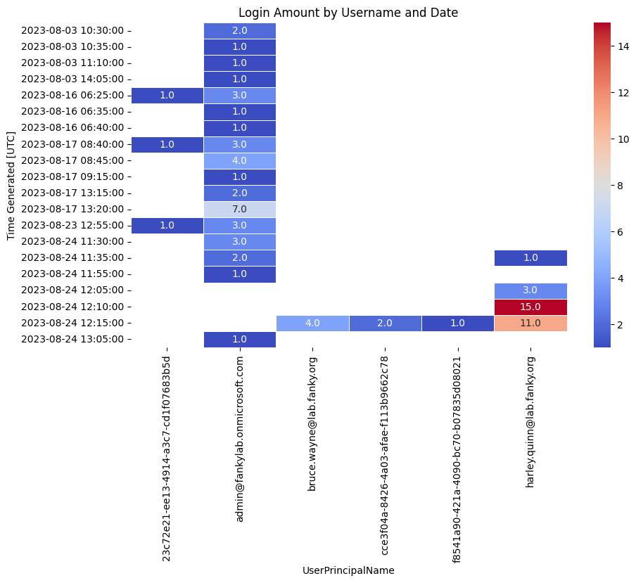
Notes:
import pandas as pd
import seaborn as sns
import matplotlib.pyplot as plt
# Sample data (replace with your DataFrame)
data = pd.read_csv('query_data.csv')
df = pd.DataFrame(data)
# Convert 'TimeGenerated [UTC]' to a datetime type
df['TimeGenerated [UTC]'] = pd.to_datetime(df['TimeGenerated [UTC]'])
# Set the 'TimeGenerated [UTC]' column as the index
df.set_index('TimeGenerated [UTC]', inplace=True)
# Create a new column with date and time with 5-minute intervals
df['DateMinute'] = df.index.floor('5T').strftime('%Y-%m-%d %H:%M:00')
# Create a pivot table, aggregating the 'Type' column by 'UserPrincipalName' and 'DateMinute'
pivot_table = df.pivot_table(values='Type', index='DateMinute', columns='UserPrincipalName', aggfunc='count')
# Create a heatmap
plt.figure(figsize=(10, 6))
sns.heatmap(pivot_table, cmap='coolwarm', annot=True, fmt=".1f", linewidths=.5)
# Set labels and title
plt.xlabel('UserPrincipalName')
plt.ylabel('Time Generated [UTC]')
plt.title('Login Amount by Username and Date')
# Show the heatmap
plt.show()

Slide 5
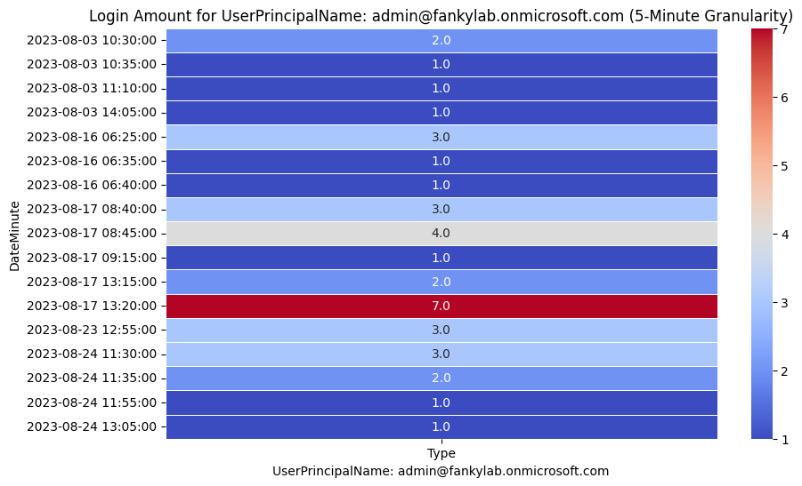
Notes:
import pandas as pd
import seaborn as sns
import matplotlib.pyplot as plt
# Sample data (replace with your DataFrame)
data = pd.read_csv('query_data.csv')
df = pd.DataFrame(data)
# Convert 'TimeGenerated [UTC]' to a datetime type
df['TimeGenerated [UTC]'] = pd.to_datetime(df['TimeGenerated [UTC]'])
# Create a new column with date and time with 5-minute intervals
df['DateMinute'] = df['TimeGenerated [UTC]'].dt.floor('5T').dt.strftime('%Y-%m-%d %H:%M:00')
# Get unique user names
unique_users = df['UserPrincipalName'].unique()
# Create a heatmap for each user
for user in unique_users:
user_df = df[df['UserPrincipalName'] == user]
# Create a pivot table, aggregating the 'Type' column by 'UserPrincipalName' and 'DateMinute'
pivot_table = user_df.pivot_table(values='Type', index='DateMinute', aggfunc='count')
# Create a heatmap
plt.figure(figsize=(10, 6))
sns.heatmap(pivot_table, cmap='coolwarm', annot=True, fmt=".1f", linewidths=.5)
# Set labels and title
plt.xlabel(f'UserPrincipalName: {user}')
plt.ylabel('DateMinute')
plt.title(f'Login Amount for UserPrincipalName: {user} (5-Minute Granularity)')
# Show the heatmap
plt.show()

Slide 6
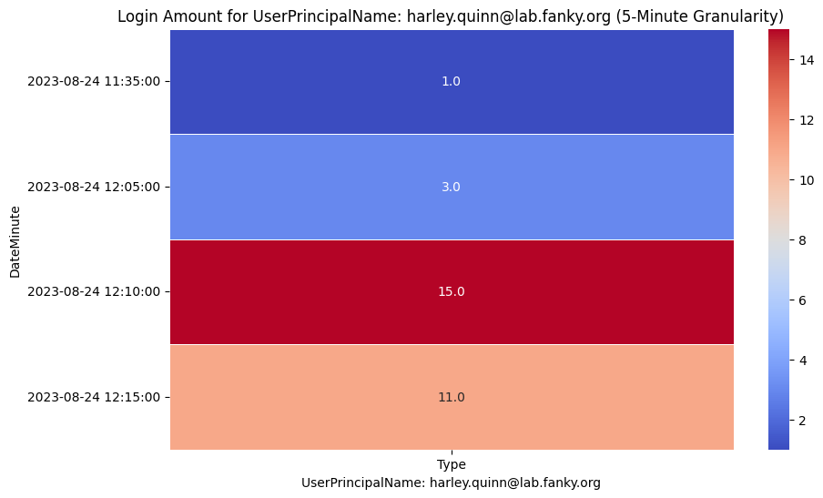
Notes:
import pandas as pd
import seaborn as sns
import matplotlib.pyplot as plt
# Sample data (replace with your DataFrame)
data = pd.read_csv('query_data.csv')
df = pd.DataFrame(data)
# Convert 'TimeGenerated [UTC]' to a datetime type
df['TimeGenerated [UTC]'] = pd.to_datetime(df['TimeGenerated [UTC]'])
# Create a new column with date and time with 5-minute intervals
df['DateMinute'] = df['TimeGenerated [UTC]'].dt.floor('5T').dt.strftime('%Y-%m-%d %H:%M:00')
# Get unique user names
unique_users = df['UserPrincipalName'].unique()
# Create a heatmap for each user
for user in unique_users:
user_df = df[df['UserPrincipalName'] == user]
# Create a pivot table, aggregating the 'Type' column by 'UserPrincipalName' and 'DateMinute'
pivot_table = user_df.pivot_table(values='Type', index='DateMinute', aggfunc='count')
# Create a heatmap
plt.figure(figsize=(10, 6))
sns.heatmap(pivot_table, cmap='coolwarm', annot=True, fmt=".1f", linewidths=.5)
# Set labels and title
plt.xlabel(f'UserPrincipalName: {user}')
plt.ylabel('DateMinute')
plt.title(f'Login Amount for UserPrincipalName: {user} (5-Minute Granularity)')
# Show the heatmap
plt.show()

Slide 7
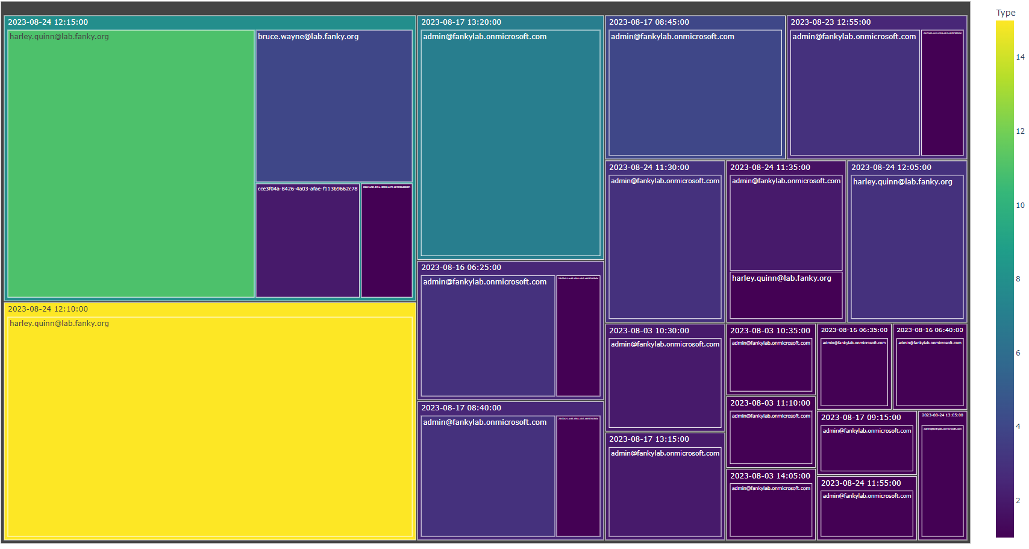
Notes:
import pandas as pd
import plotly.express as px
# Sample data (replace with your DataFrame)
data = pd.read_csv('query_data.csv')
df = pd.DataFrame(data)
# Convert 'TimeGenerated [UTC]' to a datetime type
df['TimeGenerated [UTC]'] = pd.to_datetime(df['TimeGenerated [UTC]'])
# Create a new column with date and time with 5-minute intervals
df['DateMinute'] = df['TimeGenerated [UTC]'].dt.floor('5T').dt.strftime('%Y-%m-%d %H:%M:00')
# Group by 'DateMinute', 'UserPrincipalName', and aggregate login counts
agg_df = df.groupby(['DateMinute', 'UserPrincipalName'])['Type'].count().reset_index()
# Create the tree map using Plotly Express with a larger size
fig = px.treemap(agg_df,
path=['DateMinute', 'UserPrincipalName'],
values='Type',
color='Type',
color_continuous_scale='Viridis',
title='Login Amounts by DateMinute and UserPrincipalName (5-Minute Granularity)',
)
# Increase the size of the tree map
fig.update_layout(width=1800, height=1080)
# Show the tree map
fig.show()

Slide 8
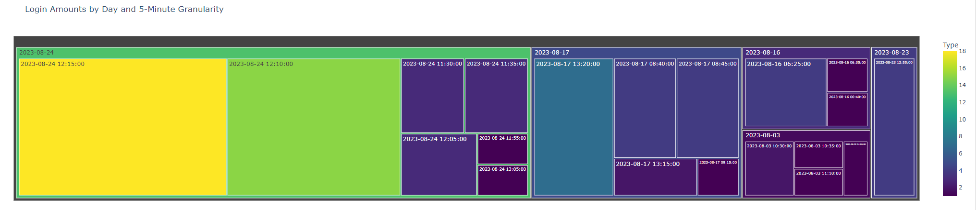
Notes:
import pandas as pd
import plotly.express as px
# Sample data (replace with your DataFrame)
data = pd.read_csv('query_data.csv')
df = pd.DataFrame(data)
# Convert 'TimeGenerated [UTC]' to a datetime type
df['TimeGenerated [UTC]'] = pd.to_datetime(df['TimeGenerated [UTC]'])
# Create a new column with date and time with 5-minute intervals
df['DateMinute'] = df['TimeGenerated [UTC]'].dt.floor('5T').dt.strftime('%Y-%m-%d %H:%M:00')
# Extract the date from 'TimeGenerated [UTC]'
df['Date'] = df['TimeGenerated [UTC]'].dt.date
# Group by 'Date' and 'DateMinute', and aggregate login counts
agg_df = df.groupby(['Date', 'DateMinute'])['Type'].count().reset_index()
# Create the treemap using Plotly Express
fig = px.treemap(agg_df,
path=['Date', 'DateMinute'],
values='Type',
color='Type',
color_continuous_scale='Viridis',
title='Login Amounts by Day and 5-Minute Granularity',
)
# Show the treemap
fig.show()

Slide 9
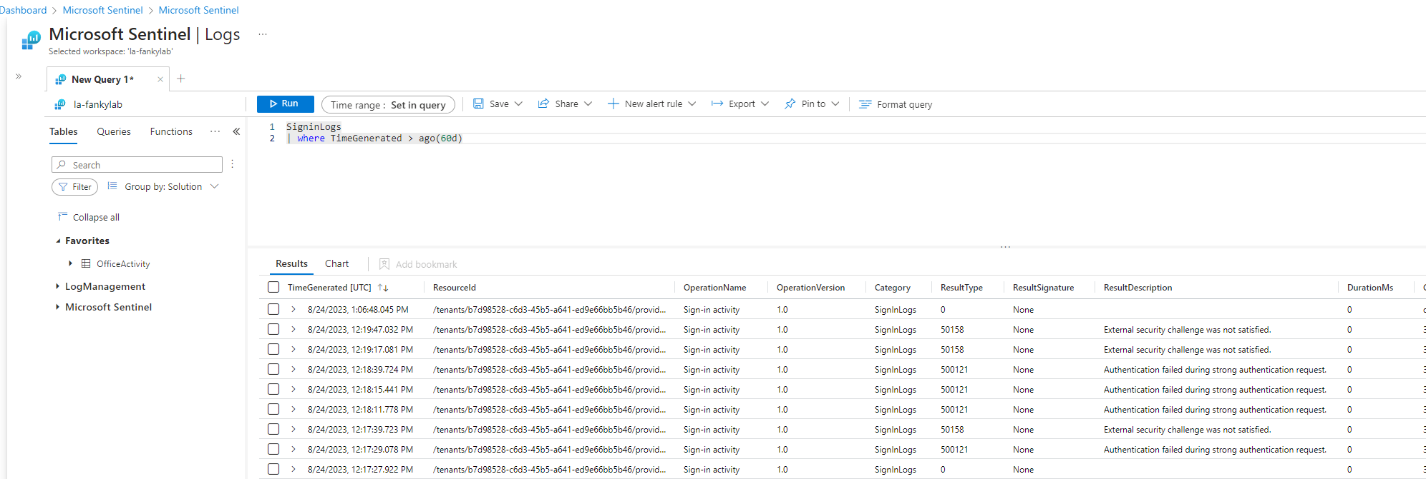
Data Analytic
Data is stored in SIEM
Already parsed (no cleaning needed)
Filtering needed
Filtering is done via KQL (Kusto Query Language)
The SignIn log has 76 columns (attribute, properties)

Slide 10
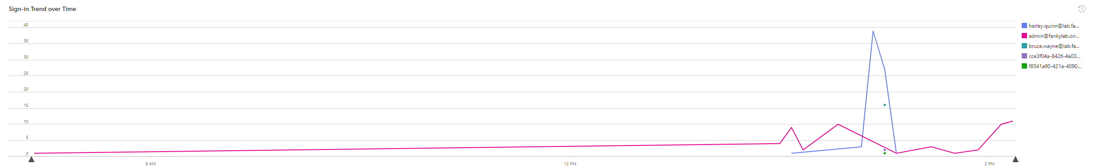
Data visualization
SignIn Trend over Time

Slide 11
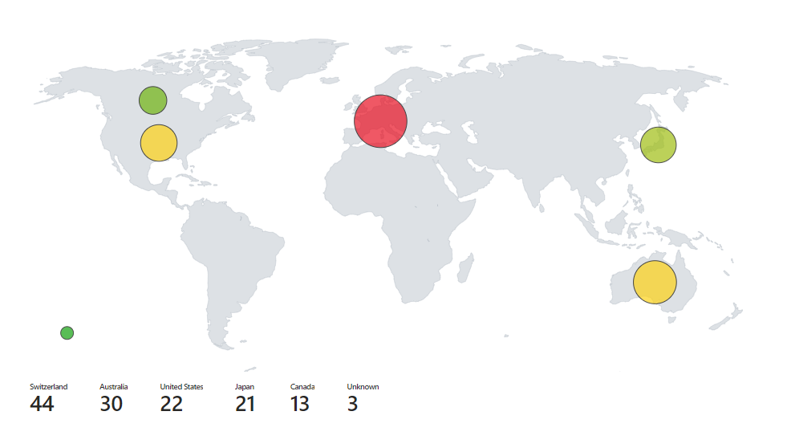
Data visualization
SignIn by Location as a map

Slide 12
Conclusion
KQL is live data and allows paramters
Python API call would be needed for live data – Important for SOC
ChatGPT is the new 42 ;)
Not ideal use case for visualization
Better (more complex - Benfords) use cases for SOC

